Slide 1
CIP - Customer Intelligence Platform
19th July 2022

Slide 2


Index
Customer Intelligence Platform [CIP] Overview
CIP – Key Accomplishments
CIP User Data Fetcher
Entain and Snapchat integration extended to multiple brands
Entain and Facebook integration extended to multiple brands
ADA model Usage Tracker
Real Time CRM Dashboard - new US labels
CIP Monitoring
Fan zone 1.0
SASW – Single Account & Single Wallet
Real Time CRM Dashboard- BetnGet
Quick Seats Personalization
E-37506 : Smart Lobby – Options for fallback
Extend Bonus Optimization, to the Casino offers for the regions of LCG, LATAM and Italy
Within Bonus Optimization, communicate to “No Offer” designated Customers.
CIP H2 Roadmap Projects - 2022
Notes:
Four key points

Slide 3
Customer Intelligence Platform – Overview
Customer Intelligence
Centralized Realtime Data
Integrations with multiple systems
Customer intelligence (CI) as part of business intelligence is the process of gathering and analyzing information regarding customers, and their details and activities, to build deeper and more effective customer relationships and improve decision-making.
Customer Behavioral and Transactional realtime data
Sports Trading Data – LadCor (Implementation complete), Entain Labels (Work In Progress)
Established – ADA (CASIA / SIA), Entain Platform, Sports, LCG Platform, Openbet, BI, Optimove, Graphyte, Adobe, SFMC, Grandstand, Facebook, Snapchat, AppsFlyer, Google Analytics
In Pipeline (till date) – Twitter, POS
Notes:
Four key points

Slide 4












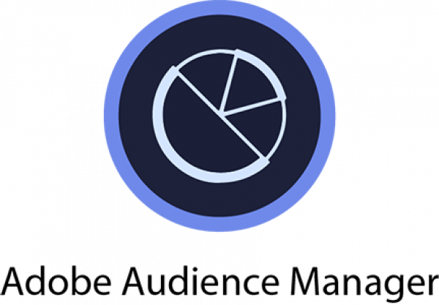







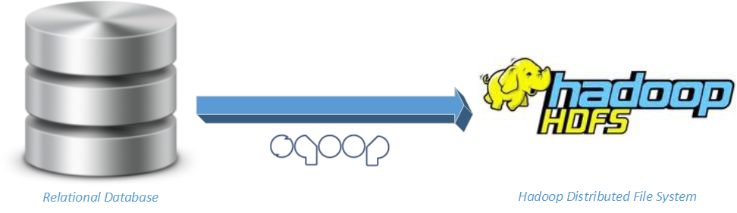


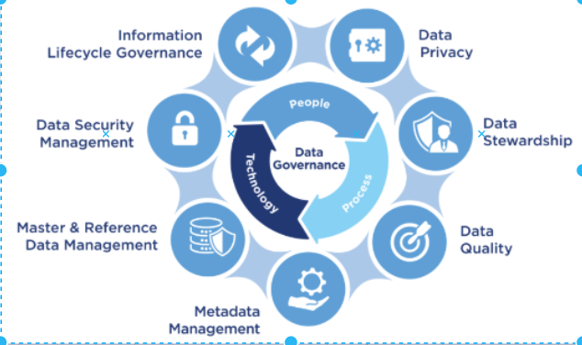




Customer Intelligence Platform [CIP]
EXTERNAL APPLICATIONS (OB, PLAYTECH)
DATA LAKE
2
1
Raw Zone
Cleanse Zone
Production Zone
microservices
NON-US APPLICATIONS
Entain Data
Teradata/Excels/Csvs
US APPLICATIONS
3
2
1
AI/ML (Apache Spark )
microservices
Notes:
Four key points

Slide 5





CIP Key Accomplishments
Snapchat and Facebook Integration
CRM Dashboard
Fanzone
One time offers
Single interface for marketing / Ops users for tracking and monitoring all CRM campaigns, rewards with realtime alerting mechanism. Additionally provides details statistics on Player logins, Cashier deposits / withdrawals, Active players etc.,
The Entain players who use Snapchat and Facebook can see now Entain Campaigns running on these apps. This helps Entain to improve the CTR and GGR.
The Entain players will be able select their favorite teams and will be able to get the notifications 3 hours before the match, half time, end of the match.
Identify the optimal daily offer to recommend for each player, in order to maximize revenue return.
Notes:
Four key points

Slide 6

CIP Deliverables – Q2 2022

Slide 7


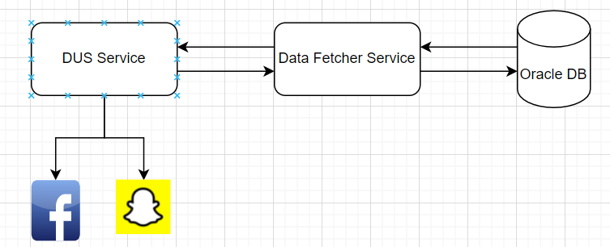
CIP User Data Fetcher
Business use case
Technical description
Problem description: Currently, we don’t have any generic service where it returns the user profile data like name, mobile , email in an encrypted format.
Label(s) impacted: All Ladbrokes & Coral Label.
Action taken: Created a Service which is capable of returning the user profile data in an encrypted format based on account_id as input.
Business benefit: This Service is used by DUS Serviceand in future many other services to send the user send/use user data to other parties.This help us in targeting the user accurately and significantly more personalized customer experience and increase in CTR (click through rate).
Architecture/Design:
Notes:
Four key points

Slide 8
Entain and Snapchat integration extended to multiple brands
Business use case
Technical description
Problem description: Snapchat needs the user events data by which they can run user campaigns accurately and it expects the data to be sent to it’s Rest Service.
Label(s) impacted: All Ladbrokes & Coral Label.
Action taken: Existing integration in DUS is now extended to multiple brands with additional elements.
Business benefit: This help us in running Entain Campaigns on Snapchat app targeting the users accurately and significantly with more personalized customer experience which increases in CTR (click through rate).
Architecture/Design:
Notes:
Four key points

Slide 9
Entain and Facebook integration extended to multiple brands
Business use case
Technical description
Problem description: Facebook needs the user data to target the users accurately for AdTech campaigns and Facebook expects this data to be in the encrypted format.
Label(s) impacted: All Ladbrokes & Coral Label.
Action taken: Encrypting the user data with the help of cip data fetcher service and sending the required data to Facebook.
Business benefit: This help us in running Entain Campaigns on Facebook app targeting the users accurately and significantly with more personalized customer experience which increases in CTR (click through rate).
Architecture/Design:
Notes:
Four key points

Slide 10
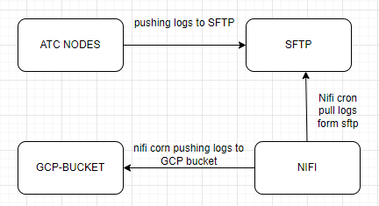
ADA Model Usage Tracker
Business use case
Technical description
Problem description: As of now, we don’t have a facility to visualize the recommendations generated and automate weekly/monthly stats for players of different sections of our website.
Label(s) impacted: All Ladbrokes & Coral Label.
Action taken: Logging all requests and corresponding recommendations to the players for different usecases in log files in A/bTest Container.
Shipping these logs to GCP buckets and creating meaningful reports on top of these.
Business benefit: This help ADA team to track what recommendation actually shown to players.
Architecture/Design:
Notes:
Four key points

Slide 11
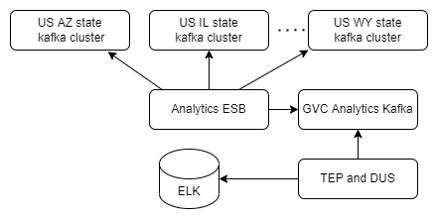
Realtime Dashboard - Addition of new US labels
Business use case
Technical description
Problem description: US events data for the states (AZ,IL,LA,MS,NV,NY,DC,WY) were not streaming as a result we are not displaying those US states data in Realtime dashboard. Also Ontario label events (ON,OW,OY) were displaying under GVC specific dashboards rather than US dashboards.
Label(s) impacted: GVC and US.
Action taken: We have created new routes in Analytics ESB to stream events data from different the above told US states to kafka topics and enabled support in TEP to process these different US state events and also configured Ontario labels(ON,OW,OY) under US labels category.
Business benefit: Now Business users can see above mentioned US states data in Realtime dashboards and Ontario labels data under US dashboards.
Architecture/Design: Analytics ESB will stream different US states data from different US kafka servers and sourcing it to the GVC analytics kafka server and from there TEP and DUS will do further processing and push necessary events data to Elasticsearch.
Notes:
Four key points

Slide 12
CIP MONITORING
Business use case
Technical description
Problem description: Currently, we don’t have a facility to identify and alerts the users when a application goes down, or its not working the way that is expected to work.
Action taken:
Implemented Elastic Search Methodologies(Monitor,Trigger,Destination) which are capable of identifying the Applications Health and send an alert mail with application details.
Business benefit: Applications Health can be monitored automatically without any Human interference and can send alerts in case of any issues.
Design: CIP consumes ADA Applications health metrics timely from Kafka, through DUS we send this data to Elastic Search to monitor the Applications' health and send an Alert Mail if Applications Health is not good.
Triggers mail via DUS
ADA
DUS
Elastic Search
Users
Notes:
Four key points

Slide 13
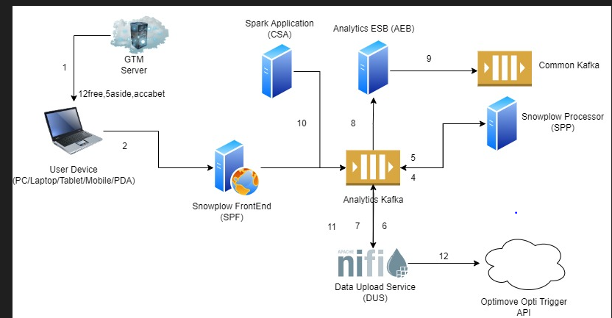
Fanzone 1.0
Business use case
Technical description
Problem description: There was no provision to end users to select their favorite team(s) and receive notifications for the matches played by his/her favorite team.
Label(s) impacted: LCG labels.
Action taken: In Portal now users can select their favorite team(s) by which they will receive email(s) before their favorite team match starts.
The role of CIP is to provide user bets and teams information based on which DCRM team would be pushing the email notification.
Business benefit: Personalized customer experience while engaging them to place bets on favorite teams.
Design:
ADA team provides CIP with matches information which is forwarded by CIP to Optimove by using their REST service. Optimove matches teams with the end users list which is forward to DCRM.
CIP sends following betting data (Acca bet, 5Aside bet and 12Free) of users to DCRM, which then identifies the users to whom they need to send the email notifications.
Architecture
Notes:
Four key points

Slide 14
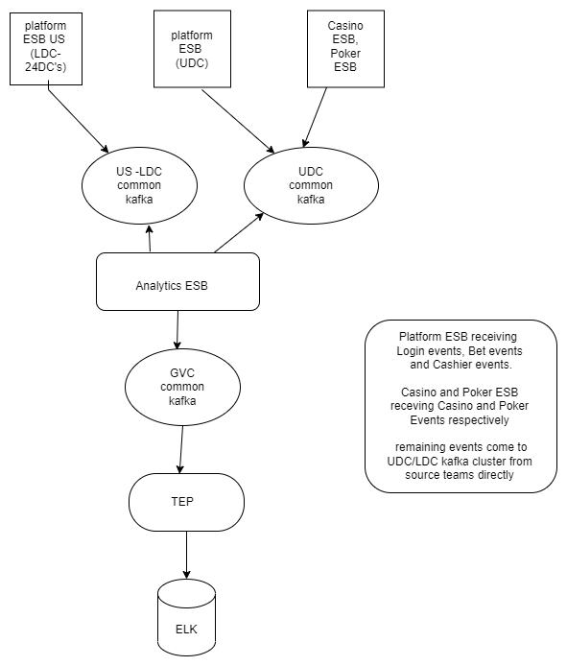
SASW
Business use case
Technical description
Problem description: Once user registered in any US state, user can play games in only that particular state. There should be a provision for user to play from anywhere in the registered state.
Label(s) impacted: US
Action taken: As part of SASW, we have a new setup called UDC, some of the services will be hosted here. From CIP we made changes in Analytics ESB and Platform ESB to stream data from both LDC and UDC setups. Events coming from UDC kafka server: bonus, bet, cashier, eds, login, promo, wallet events Events coming from LDC Kafka server: bingo, casino, poker events
Business benefit: Once user registered in any US state, user can play game in any US state which improves the CTR for Entain.
Architecture/Design:
Notes:
Four key points

Slide 15
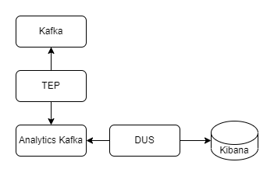
CRM Bet & Get
Business use case
Technical description
Problem description: As of now we don’t have the facility to visualize the Bet and Get reward metrics and reports.
Label(s) impacted: GVC, LCG and US labels
Action taken: Created consumers in TEP, to consume all Bet and Get events from Kafka and created new Bet and Get dashboard in Kibana
Business benefit: Business users can see Bet and Get metrics and reports in Kibana dashboard.
Architecture/Design: TEP will consume all Bet and Get events from Kafka and source it to GVC analytics Kafka, from there DUS will process and pushed to Elasticsearch
Notes:
Four key points

Slide 16
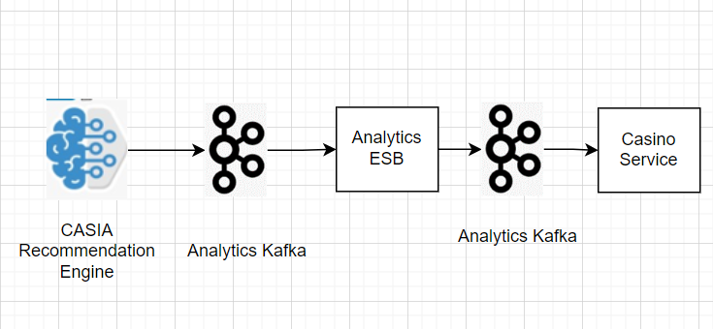
Quick Seats Personalization
Business use case
Technical description
Problem description: Player may be directed to a table that is not suited to their usual staking levels. We would like to automate table selections on Quick Seats that corresponds to the usual betting of each individual player.
Label(s) impacted: LCG,GVC,US labels.
Action taken: CIP streams the game recommendations to Casino systems so that same will be displayed in the frontend.
Business benefit:
Improves player engagement
Improves retention rate
Improves GGR
Design:
ADA teams sends the games that corresponds to the player usual betting, CIP streams the data to Casino systems so that same will be displayed in the frontend.
Architecture
Notes:
Four key points

Slide 17
Smart Lobby - Options for fallback
Business use case
Technical description
Problem description: Ability to have fallback mechanism when CASIA returns empty game list for a player.
Label(s) impacted: LCG,GVC,US labels.
Action taken: CIP streams the game recommendations to Casino systems so that same will be displayed in the frontend.
Business benefit:
Increase player experience
Improves engagement and thus helps in retention
Design:
ADA teams sends the fall back games when a player doesn’t have any recommendation, CIP streams the data to Casino systems so that same will be displayed in the frontend.
Architecture
Notes:
Four key points

Slide 18
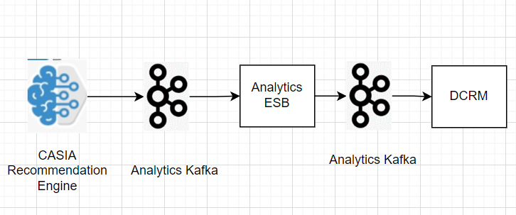
Extend Bonus Optimization, to the Casino offers for the regions of LCG, LATAM and Italy
Business use case
Technical description
Problem description: Identify the optimal daily offer to recommend for each player, in order to maximize revenue return
Label(s) impacted: LCG,LATAM,Italy labels.
Action taken: CIP streams the recommended offers to DCRM systems so that offers will be awarded to the players through the campaign hub
Business benefit:
Improves retention rate
Improves GGR
Design:
ADA teams recommended offers that are corresponds to the player usual behavior, CIP streams the data to DCRM systems so that same will be awarded to the players through the campaign hub.
Architecture
Notes:
Four key points

Slide 19
Within Bonus Optimization, communicate to “No Offer” designated Customers
Business use case
Technical description
Problem description: Identify the optimal daily No offer/communications to recommend for each player, in order to maximize player retention and engagement
Label(s) impacted: LCG,GVC,US labels.
Action taken: CIP streams the recommended No offer/communications to DCRM systems so that communication will be sent out to the players through the campaign hub
Business benefit:
Improves retention rate
Improves player engagement
Design:
ADA teams recommended communication that are corresponds to the player usual behavior, CIP streams the data to DCRM systems so that communication will be sent out to the players through the campaign hub.
Architecture
Notes:
Four key points

Slide 20
CIP H2 Roadmap Projects - 2022
Notes:
Four key points

Slide 21
CIP - H2 Roadmap projects - 2022
Project Name | Description | Type | Quarter
Dynamic Bet - BI/CDNA (Each Player Vs Game Group) | Bet recommendation for CASINO games via CASIA at game type level | Secondary | Q3
Dynamic Bet - CasiA (Each Player Vs Each Game) | Bet recommendation for CASINO games via CASIA at game level | Secondary | Q3
Automation Of Value statements | Summary of player’s sports rewards through various communication channels for last 30 days. | Secondary | Q3
Audience uplift for grandstand campaigns | Based on players historical betting activity, Grandstand will target the most appropriate campaign(Event/market/outcome) to the user. | Secondary | Q3
Segmentation and personalization of EzNav options LCQ4-12 | All players see exactly the same Eznav Game Proposition options irrespective of their product preference and previous interaction with the menu or current bets. Changes needed to display Eznav menu items that are relevant to the player. | Secondary | Q3
Unikrn Integration (Brazil, Canada, UK) | Integrate the new Unikrm with Entain platform | Secondary | Q3
Ireland - Play breaks | Extending play breaks and long sessions ARC feature to Ireland players | Secondary | Q3
ARC-Tailored GC Interceptor | Integration | As part of extending ARC related features to International brands, for customers who are in Risk Level 3, 4; we would like to have the recommended/tailored gambling control interceptors displayed on login. These recommendations help the players in being control and have a safer and responsible gambling | Secondary | Q3
ENABLE REVENUE SHARE FOR PLAYERS REACTIVATED BY YAHOO (Yahoo Re-Attribution) | Sending the player list back to yahoo if the player is reactivated by Yahoo based on this revenue will be shared to yahoo | Secondary | Q3
Notes:
Four key points

Slide 22
CIP Roadmap projects – 2022 (..Contd.)
Project Name | Description | Status | Quarter
SIA/CASIA cluster – Add more resource to the SIA/CASIA cluster | Scaling of SIA/CASIA cluster resources | Primary | Q2-Q3
E-36950 --Trading real time data to be made available on ROW brands (mirroring what’s available for Lads and Coral) | The UK Sports Brands want a way to showcase the value their customers get by surfacing a 'value statement' on site for customers to know what they are getting/could be getting from the promotions available to them. | Primary | Q2-Q3
Synchronous Model Deployment and Serving using CIP | Providing the infra to generate the recommendations on demand | Primary | Q2-Q3
KAFKA and JAVA Upgrade | KAFKA and JAVA Upgrade | Primary | Q2-Q3
Value Perception | This project enables user to view the gained value by him/her by playing different Bonus Promotions of Entain. | Primary | Q2-Q3
TWITTER Integration for user events | User events like deposit, bet placed registration etc. need to send to Twitter so that Entain Campaigns would be displayed on Twitter App. | Primary | Q3
Autocomplete Search POC | This is to implement the prefix search feature. User behavioral search is the new enhancement being analyzed. | Primary | Q2-Q3
Notes:
Four key points

